Slide 1
CSE 583: Digital Image Processing Introduction

Slide 2
Reference Book
Digital Image Processing, 4th Edition
Rafael C. Gonzalez, Richard E. Woods
Digital Image Processing Using MATLAB, 3rd Ed.
Rafael C. Gonzalez, Richard E. Woods and Steven L. Eddins

Slide 3
Journals & Conferences in Image Processing
Journals:
— IEEE T IMAGE PROCESSING
— IEEE T MEDICAL IMAGING
— INTL J COMP. VISION
— IEEE T PATTERN ANALYSIS MACHINE INTELLIGENCE
— PATTERN RECOGNITION
— COMP. VISION AND IMAGE UNDERSTANDING
— IMAGE AND VISION COMPUTING
Conferences:
— CVPR: Comp. Vision and Pattern Recognition
— ICCV: Intl Conf on Computer Vision
— ACM Multimedia
— ICIP: INTL. CONF IMAGE PROCESSING
— SPIE
— ECCV: European Conf on Computer Vision
— CAIP: Intl Conf on Comp. Analysis of Images and Patterns
For detail:
https://scholar.google.com/citations?view_op=top_venues&hl=en&vq=eng_computervisionpatternrecognition

Slide 4
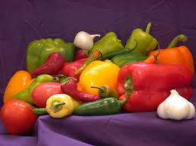
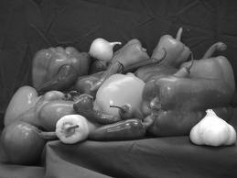
What is an Image/Digital Image
A matrix
OR
2 D function
a gray scale (black/white) image

Slide 5

What is an Image/Digital Image
A gray scale image
y
f(x, y) can take any value from 0.0 (black) to 1.0 (white)
f(x, y)
x
2 attributes:
A location (x, y): picture element, pixel, etc
A value f(x, y) at pixel (x, y): gray scale value

Slide 6

What is an Image/Digital Image
y
f(x, y)
f(x, y) can take any value from 0.0 (black) to 1.0 (white)
x
Similarly: x and y can take any real numbers

Slide 7
What is a Digital Image
A gray scale image
y
f(x, y)
x
Digital image means
pixels locations (x, y) are discrete
gray level values f(x,y) are also discrete

Slide 8
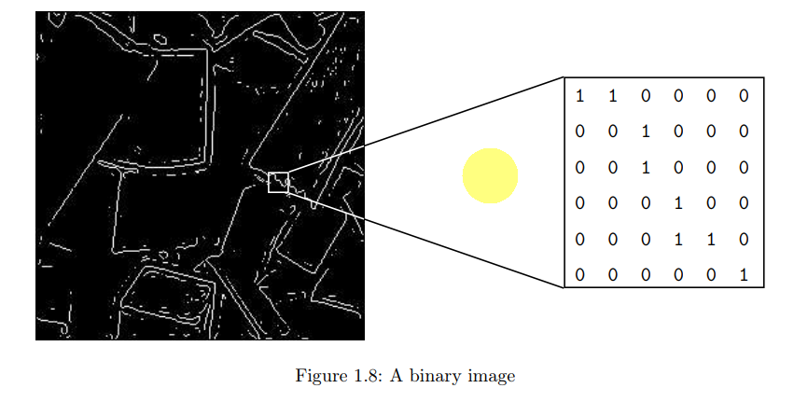
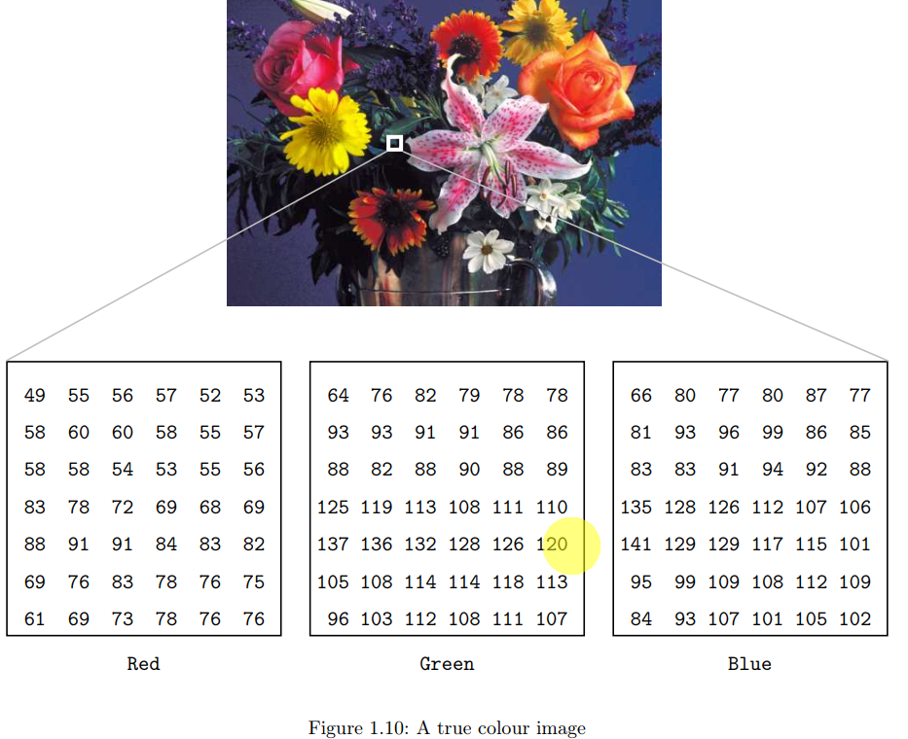
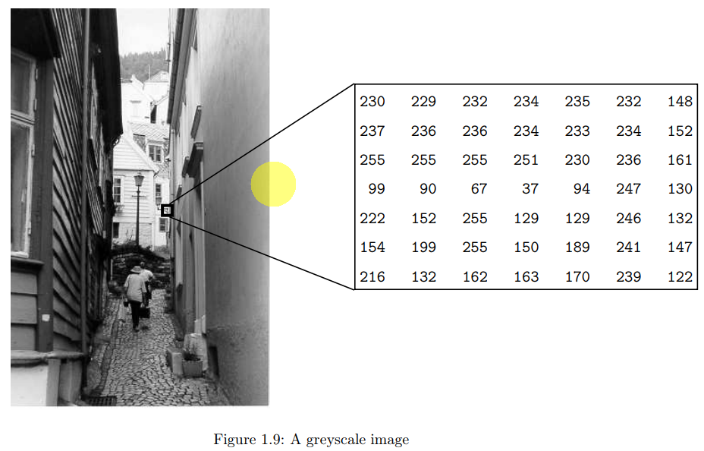
Types of image

Slide 9
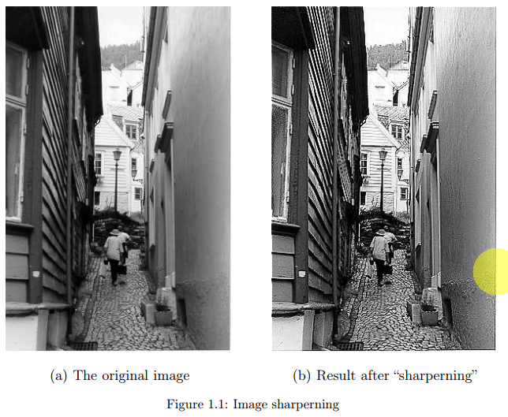
Scope of DIP
Sometimes difficult to define the scope
Usually: Input/output are images
DIP

Slide 10
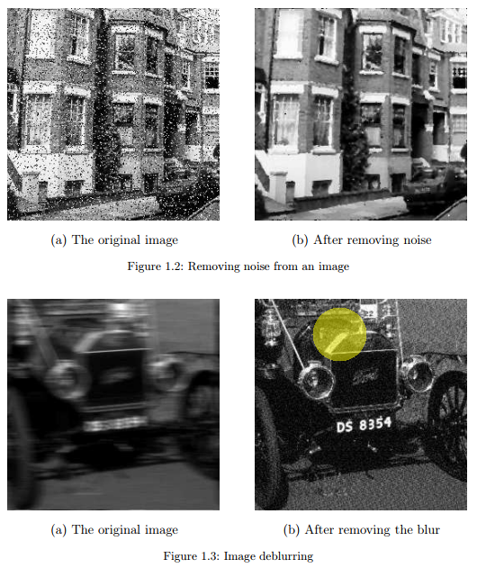
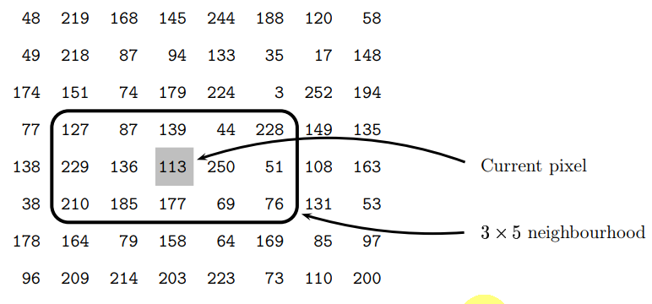
Find avg. gray value
0.67

Slide 11
Scope of DIP
Computer Vision: a branch of DIP
emulates human vision through learning
However, it itself is a branch of AI, too.

Slide 12
Scope of DIP
3 levels of DIP
Low level
I/O: both are images
Noise removal, enhancement, sharpening
Mid level:
Output is object, regions
Image segmentation
High level:
Recognition, classification, etc

Slide 13

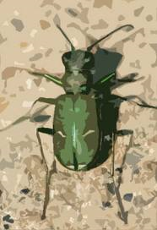

Why we need DIP
Tiger Woods makes his second ...
Tiger Lilly
Tiger beetle

Slide 14
Why we need DIP
uses only file name or text descriptions
does not look for the image content
Rather, we could use DIP to extract characteristics/features
We could let the machine learn the features and understand the images

Slide 15
Why we need DIP
DIP is not limited to image retrieval (IR)
Thousands of real world applications:
Biometric application: Face recognition, finger print
Medical imaging: automatic scanning and detection, X-ray, CT, MRI
Security and surveillance
Environmental monitoring and remote sensing
and so on, . . .

Slide 16
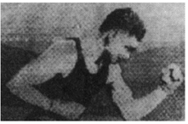
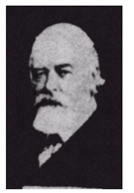
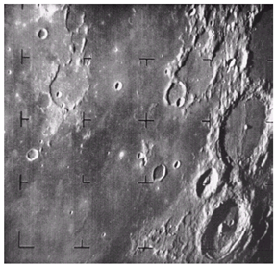
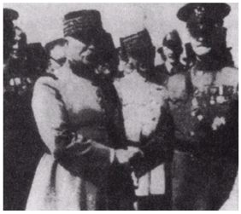
Origin of DIP - Crossing the Atlantic
1921
Journey between London
and New York
1929
First picture of the moon at 1964
taken by spacecraft Ranger 7
1922

Slide 17
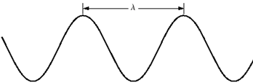
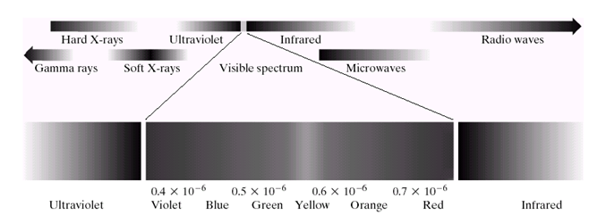
Image Source
Electromagnetic (EM) Spectrum: Sinusoidal wave with varying frequency
Radio wave
Gamma rays

Slide 18
Image Source
Each energy band can produce image
Need appropriate sensor to see the spectrum
Human can see only the visible spectrum
High energy spectrum can be dangerous for the human eye.

Slide 19
What is Imaging?
Digital imaging is the process of converting a picture or document into a digital file stored on a computer.
This process is accomplished through the use of a scanner, digital camera, or other devices.
Imaging with
Gamma-Ray
X-ray
Ultraviolet
Visible and Infrared
Microwave
Radio, MRI
Ultra-sound Imaging
Images generated by 3D computer model

Slide 20
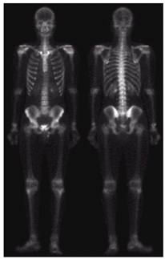
Gamma Ray Imaging
Main uses:
Astronomy
Nuclear medicine
Inject radio active element into body
Radiations collected by gamma ray detectors

Slide 21
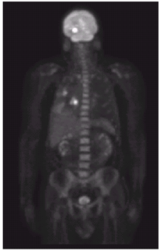
Gamma Ray Imaging
PET (Positron Emission Tomography) Imaging:
Similar to CAT or CT imaging

Slide 22
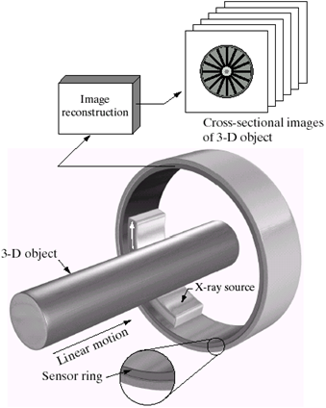
CT, CAT, PET Technology
These have similar arrangements
CAT, CT (computed tomography):
allows doctors to see inside your body. It uses a combination of X-rays and a computer to create pictures of your organs, bones, and other tissues. It shows more detail than a regular X-ray.
PET (Positron emission tomography): injected radioactive element which emits positron

Slide 23
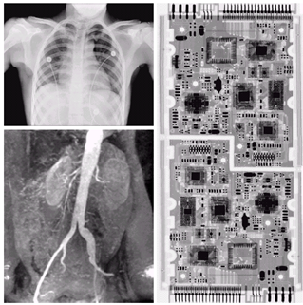
X-Ray Imaging
Too many uses
Medical diagnostic
Security
Factory inspection, etc
Object is placed in between source and sensor film

Slide 24
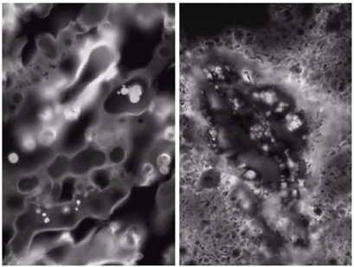
UV Imaging
Used in fluorescence microscopy
Way:
UV ray directed to a fluorescent material
Excited material emits visible (red) light which is then detected
Good corn
Corn with ‘smut’

Slide 25
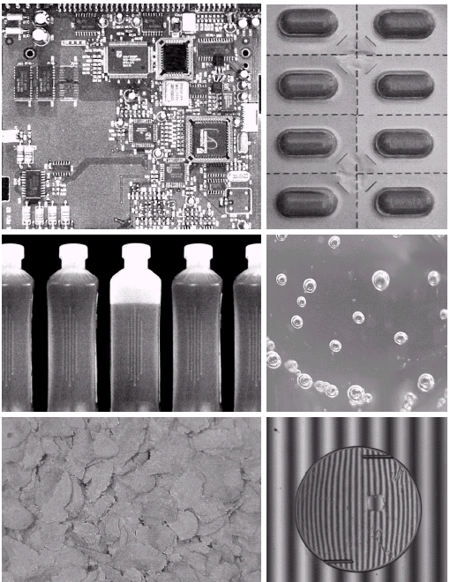
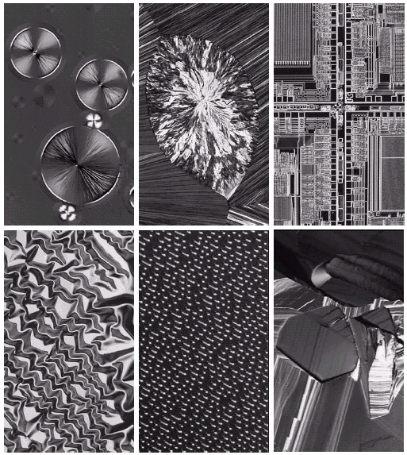
Imaging in Visible and Infrared
Outnumbered all other bands
Images for visual Inspection
Microscopic images

Slide 26
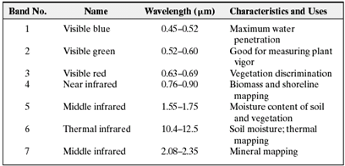
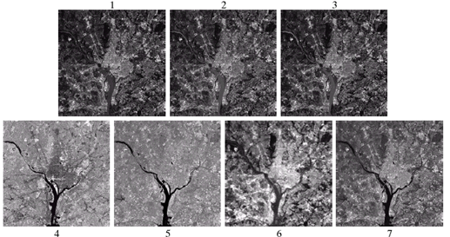
Imaging in Visible and Infrared
Infrared imaging

Slide 27
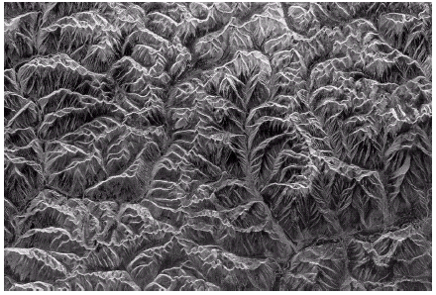
Imaging in microwave band
Radar
can see at any region at any time, at any condition
uses its own illumination (microwave pulse) to illuminate the object
collects reflected energy by antenna
is suitable for inaccessible region
Mountains in southern Tibet

Slide 28
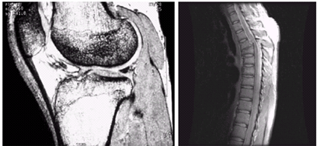
Imaging in radio band
MRI (Magnetic resonance imaging)
Patient is placed in a strong magnetic place
Radio wave passes through body

Slide 29
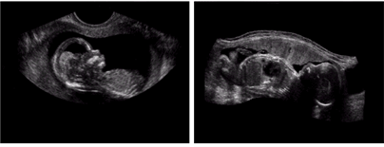
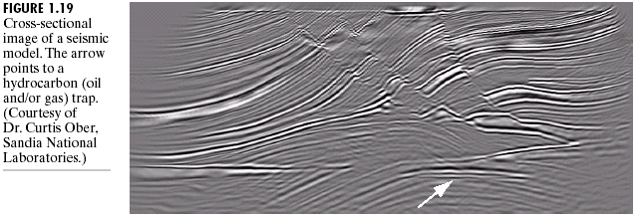
Imaging from other modalities
Ultrasound
Seismic imaging directs an intense sound source into the ground to evaluate subsurface conditions and to possibly detect high concentrations of contamination.
Receivers called geophones, analogous to microphones. Data processing turns these signals into images of the geologic structure.

Slide 30
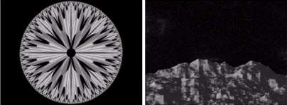
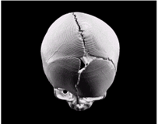
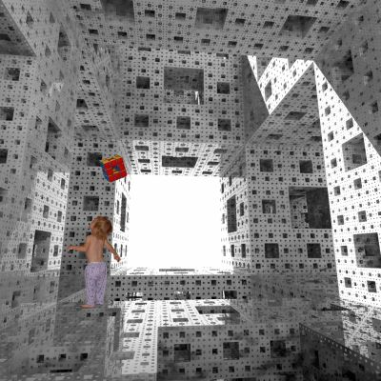
Imaging from Computer Models
Fractal : replicating self similar pattern
3D model
Part of Computer Graphics

Slide 31
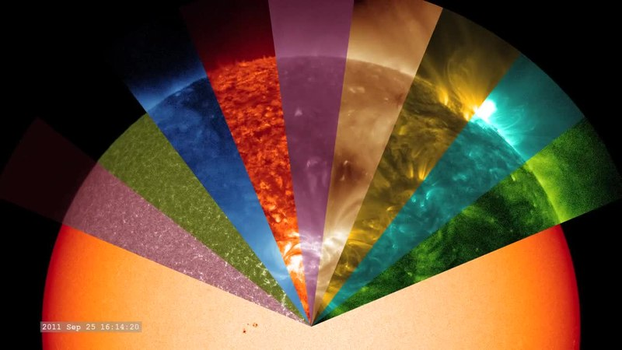
Multispectral image
A multispectral image is one that captures image data within specific wavelength ranges across the electromagnetic spectrum.
The wavelengths may include light from frequencies beyond the visible light range, i.e. infrared and ultra-violet.
https://en.wikipedia.org/wiki/Multispectral_image

Slide 32
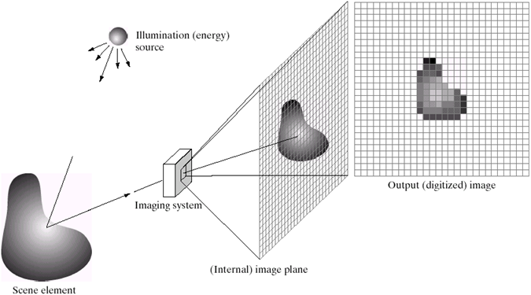
Image Acquisition using Sensor Array

Slide 33
Image Digitization
Sampling
Digitizing coordinates
Quantization
Digitizing amplitudes (gray scale values)

Slide 34
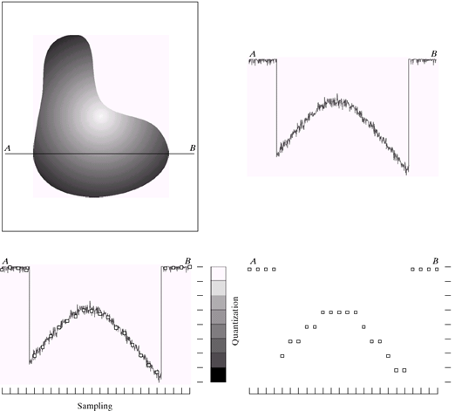
Image Digitization

Slide 35
Image Digitization

Slide 36
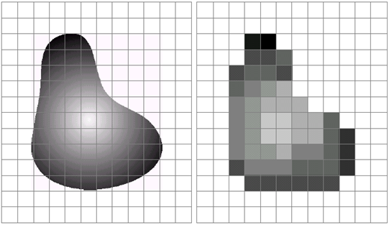
Image Digitization

Slide 37
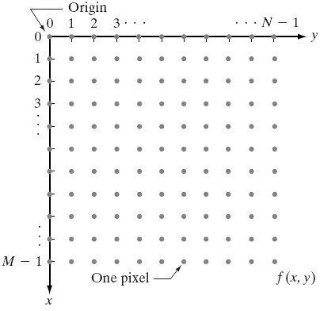
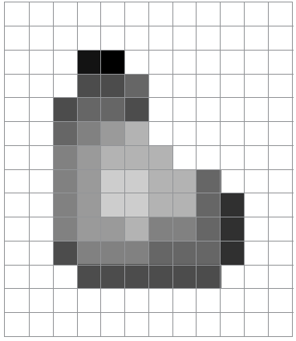
Representation of Digital Image
Matrix Representation

Slide 38
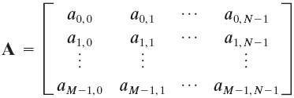
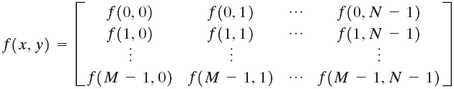
Representation of Digital Image
Traditional Matrix Representation

Slide 39
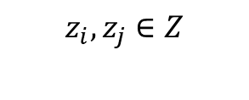
Representation of Digital Image
Formally,
Sampling:
Dividing (x, y) plane into grid with coordinate (z_{i}, z_{j}), where,
Intermediate:
Assign gray level value from R to f(z_{i}, z_{j})
Quantization:
Assign gray level value from Z to f(z_{i}, z_{j})
$$z_{i},z_{j}∈Z$$

Slide 40
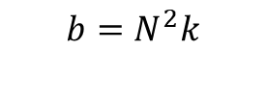

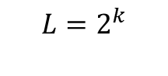
Representation of Digital Image
Number of gray levels, L, is usually power of 2:
Number of Rows (M) and Columns (N) can be any integer
Bit size of an image:
For Square image,
$$L=2^{k}$$
$$b=M×N×k$$
$$b=N^{2}k$$

Slide 41
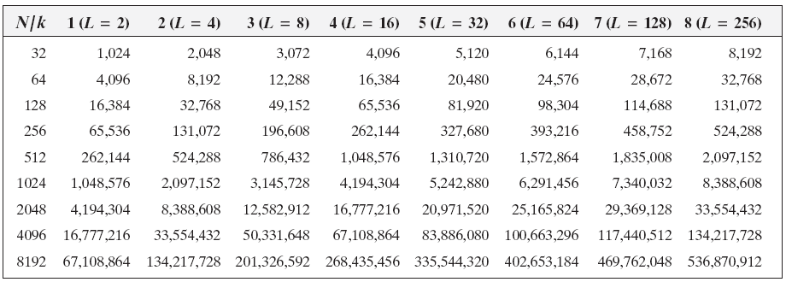
Image Sizes for Different Spatial and Gray Level Resolutions
* The calculation is for square images

Slide 42
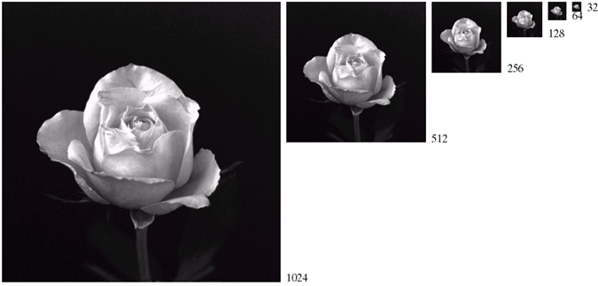
Effect of Spatial Resolutions
sub sampled from 1024X1024 up to 32X32
unchanged gray level
Delete alternate row and column while sub sampling

Slide 43
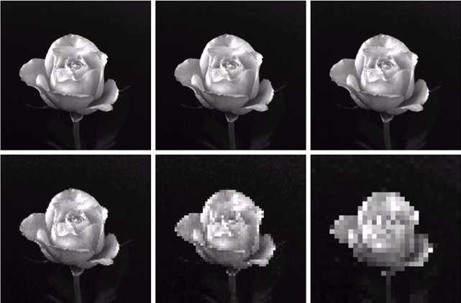
Effect of Spatial Resolutions
resized to 1024X1024
From
1024X1024
512X512
256X256
From
128X128
64X64
32X32

Slide 44
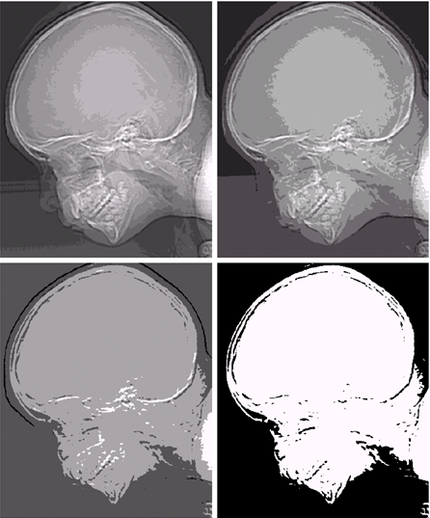
Effect of Gray level Resolutions
Gray level changed from 16 to 2
Ridge-like structure is more prominent
Reason: insufficient number of gray levels used

Slide 45
Properties of Digital Images: Zooming and Shrinking
Related to sampling and quantization, because
Zooming: over sampling
Shrinking: under sampling
However, Zooming and Shrinking are done on digital images

Slide 46
Zooming
Nearest neighbor interpolation
Pixel replication
Bilinear interpolation

Slide 47

Zooming
Nearest neighbor interpolation
An 8X8 image
Resize this image to 12X12

Slide 48
Zooming
Nearest neighbor interpolation
An 8X8 image
Resize this image to 12X12
A 12X12 grid to be filled up
Overlay it to 8X8

Slide 49
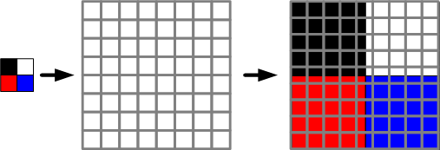
Zooming
Nearest neighbor interpolation
Each grid of 12X12 fall on some of the 8X8 grid
Fill the grid of 12X12 from the value of the nearest grid of 8X8
Then return the 12X12 into its original size
An 8X8 image
Resize this image to 12X12
Implementation outline: https://www.giassa.net/?page_id=207

Slide 50
Zooming
Nearest neighbor interpolation
An 8X8 image
Resize this image to 12X12

Slide 51
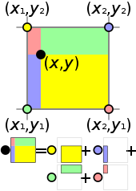
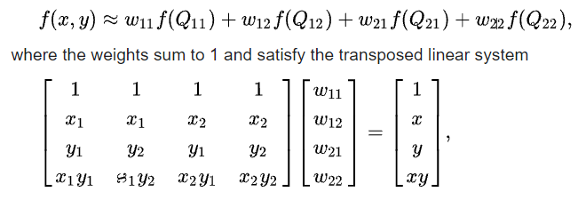
Zooming
Pixel replication
Bilinear interpolation
Let (x,y) be the pixel loc of a zoomed image
Its gray value, f(x, y)
where, w11, w12, w21, w22: determined from neighbor pixels

Slide 52
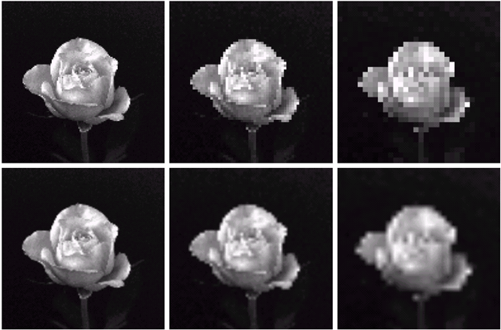
Zooming Comparison
resized to 1024X1024
From
128X128
64X64
32X32
Pixel replication
Bilinear interpolation

Slide 53

Basic Relationships Between Pixels
Neighbors of a pixel p at coordinates (x,y)
4-neighbors of p, denoted by N₄(p):
(x-1, y), (x+1, y), (x,y-1), and (x, y+1).
4 diagonal neighbors of p, denoted by N_{D}(p):
(x-1, y-1), (x+1, y+1), (x+1,y-1), and (x-1, y+1).
8 neighbors of p, denoted N₈(p)
N₈(p) = N₄(p) U N_{D}(p)

Slide 54



Slide 55
Basic Relationships Between Pixels
Adjacency
Let V be the set of intensity values
4-adjacency: Two pixels p and q with values from V are 4-adjacent if q is in the set N₄(p).
8-adjacency: Two pixels p and q with values from V are 8-adjacent if q is in the set N₈(p).

Slide 56
Basic Relationships Between Pixels
Adjacency
Let V be the set of intensity values
m-adjacency: Two pixels p and q with values from V are m-adjacent if
(i) q is in the set N₄(p), or
(ii) q is in the set N_{D}(p) and the set N₄(p) ∩ N₄(q) has no pixels whose values are from V.

Slide 57
Basic Relationships Between Pixels
Path
A (digital) path (or curve) from pixel p with coordinates (x₀, y₀) to pixel q with coordinates (x_{n}, y_{n}) is a sequence of distinct pixels with coordinates
(x₀, y₀), (x₁, y₁), …, (x_{n}, y_{n})
Where (x_{i}, y_{i}) and (x_{i-1}, y_{i-1}) are adjacent for 1 ≤ i ≤ n.
Here n is the length of the path.
If (x₀, y₀) = (x_{n}, y_{n}), the path is closed path.
We can define 4-, 8-, and m-paths based on the type of adjacency used.

Slide 58
Examples: Adjacency and Path
V = {1, 2}
0 1 1 0 1 1 0 1 1
0 2 0 0 2 0 0 2 0
0 0 1 0 0 1 0 0 1

Slide 59
Examples: Adjacency and Path
V = {1, 2}
0 1 1 0 1 1 0 1 1
0 2 0 0 2 0 0 2 0
0 0 1 0 0 1 0 0 1
8-adjacent

Slide 60
Examples: Adjacency and Path
V = {1, 2}
0 1 1 0 1 1 0 1 1
0 2 0 0 2 0 0 2 0
0 0 1 0 0 1 0 0 1
8-adjacent
m-adjacent

Slide 61
Examples: Adjacency and Path
V = {1, 2}
01,1 11,2 11,3 0 1 1 0 1 1
02,1 22,2 02,3 0 2 0 0 2 0
03,1 03,2 13,3 0 0 1 0 0 1
8-adjacent
m-adjacent
The 8-path from (1,3) to (3,3):
(1,3), (1,2), (2,2), (3,3)
(1,3), (2,2), (3,3)
The m-path from (1,3) to (3,3):
(1,3), (1,2), (2,2), (3,3)

Slide 62
Question 1
In the following arrangement of pixels, are the two regions (of 1s) adjacent? (if 8-adjacency is used)
1 1 1
1 0 1
0 1 0
0 0 1
1 1 1
1 1 1
Region 1
Region 2

Slide 63
Question 2
In the following arrangement of pixels, are the two parts (of 1s) adjacent? (if 4-adjacency is used)
1 1 1
1 0 1
0 1 0
0 0 1
1 1 1
1 1 1
Part 1
Part 2

Slide 64
In the following arrangement of pixels, the two regions (of 1s) are disjoint (if 4-adjacency is used)
1 1 1
1 0 1
0 1 0
0 0 1
1 1 1
1 1 1
Region 1
Region 2

Slide 65
In the following arrangement of pixels, the two regions (of 1s) are disjoint (if 4-adjacency is used)
1 1 1
1 0 1
0 1 0
0 0 1
1 1 1
1 1 1
foreground
background

Slide 66
Distance Measures
Given pixels p, q and z with coordinates (x, y), (s, t), (u, v) respectively, the distance function D has following properties:
D(p, q) ≥ 0 [D(p, q) = 0, iff p = q]
D(p, q) = D(q, p)
D(p, z) ≤ D(p, q) + D(q, z)

Slide 67
Distance Measures
The following are the different Distance measures:
a. Euclidean Distance :
D_{e}(p, q) = [(x-s)² + (y-t)²]^{1/2}
b. City Block Distance:
D₄(p, q) = |x-s| + |y-t|
c. Chess Board Distance:
D₈(p, q) = max(|x-s|, |y-t|)

